Slide 1
University Infrastructure Presentation
By Mr. Vann Bunthirith

Slide 2
Presentation Contents
System Infrastructure
E-Marketing
Academic Infrastructure
Qualification
Certified
Leadership
Qs and As

Slide 3
1. System Infrastructure: System Infrastructure Factors
User (Works, Workflow,…)
Developer(Coding, data structure, management,…)
Workflow/work process
Demand
Support(Financially, Emotional, and ideally)
Environment/Economic/Politic

Slide 4
1. System Infrastructure: IT Perspective
Testing(student Profile, Types of Test and results)
Cashier(Student Payment)
Enrollment(studies, Courses(Weight(GPA),Price, Curriculum, Classification)
Grading
HR and Payroll
Online Portals(News, Infor., Grade, Schedule, Enrollment, Payment,…)

Slide 5
1. System Infrastructure: Significant Features
User Friendly interface(Explorer, Classification, Automate tools,…)
Add many students to Class or group by their IDs
Auto Promote to other terms
Statistics on Payment, Enrollment and Grade, grouped by Term, Class and Promotion, and ordered by naming
Auto Grade updated based on School policy
Complicated Attendance sheet

Slide 6
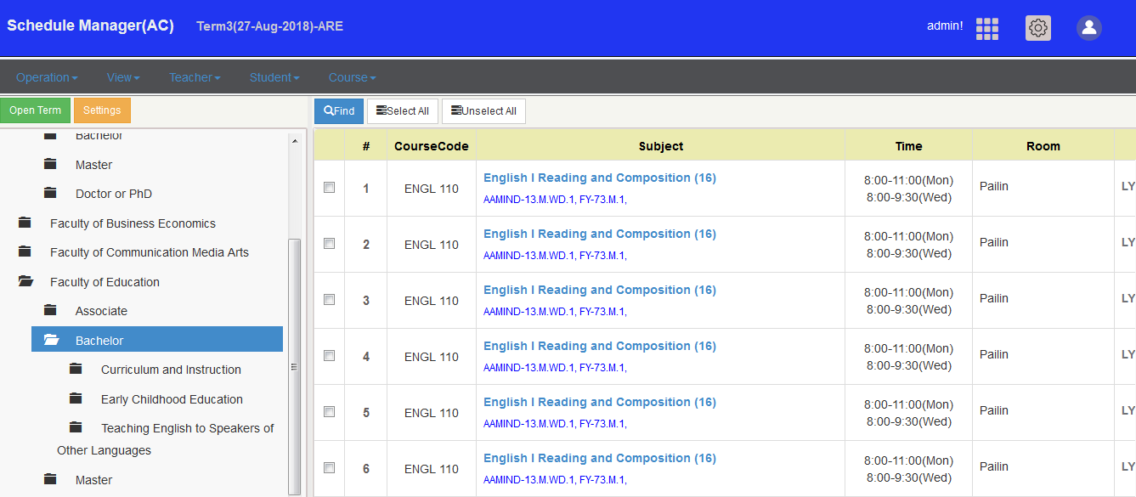
User Friendly interface

Slide 7
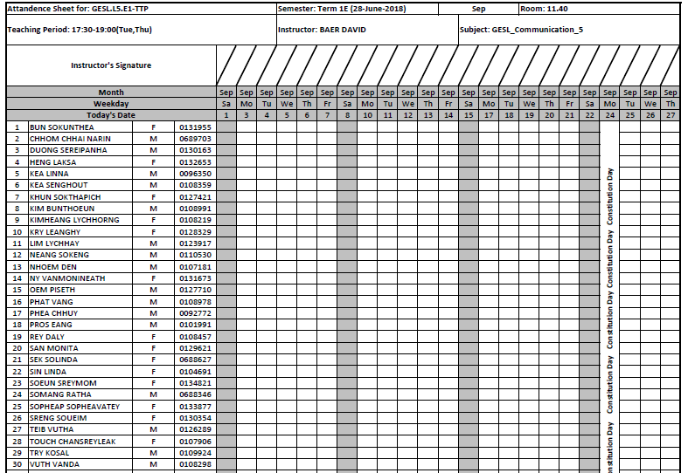
Complicated Attendance sheet

Slide 8
1. System Infrastructure: Testing, Cashier and Enrollment Period (3-6months) and Notes
Not included, system/workflow observation
Not included, data migration
Not included, system orientation
Not included, Complicated, additional functions or reports

Slide 9
1. System Infrastructure: Network Perspective
LANs and Security
Internet Usage reports
Banned and Allowed
Wireless technologies(Individual or Controller)

Slide 10
2. E-Marketing: Web
Management(Grouped and Organized )
Navigation
Activities(MoU, Clubs, Interested Groups, News,…)
Authors, Writers and editors
Graphic(Standard and Ratio)
Simplicity and Varieties

Slide 11
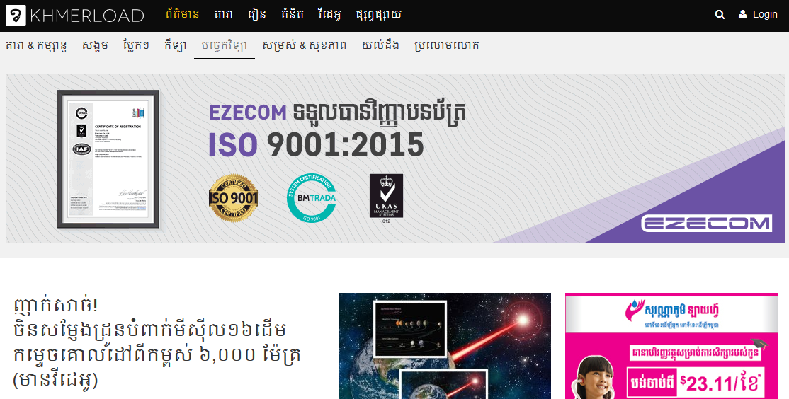
Management(Grouped and Organized )

Slide 12
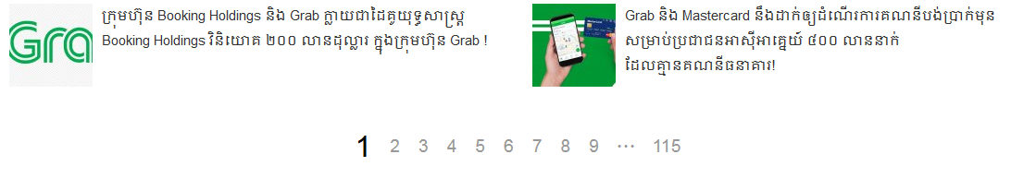
Navigation

Slide 13
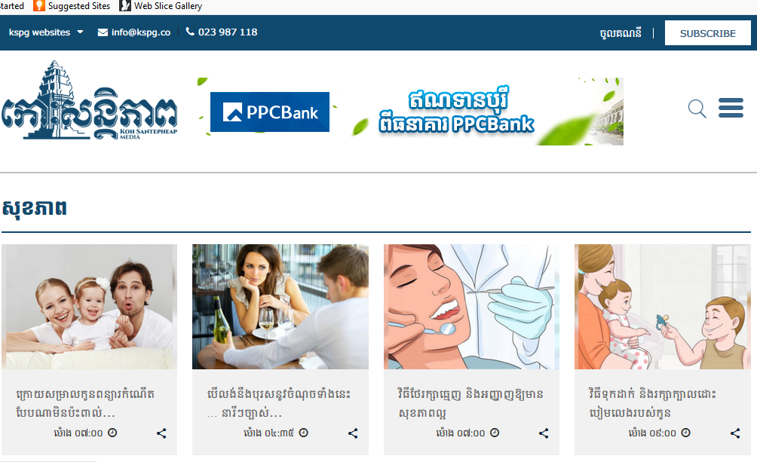
Simplicity and Varieties

Slide 14
2. E-Marketing: Web with Internal System (cont.)
News
Information
Grade
Schedule
Enrollment
Payment
Etc.

Slide 15
3. Academic Infrastructure: IT Education
Up to date courses and not redundant
Varieties of IT Skills(Programming, Networking, Web, Phone Development)
Qualifications and Certified(Industry, Regional, Instructor and student)

Slide 16
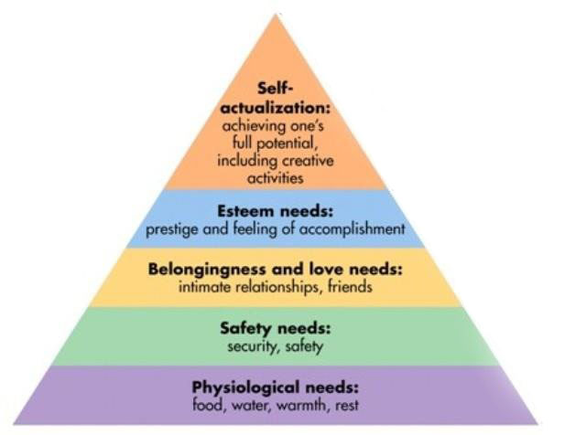
3. Academic Infrastructure: Need Diagram
High Esteem and Achievement
Global Qualified Education
Standard Education
Knowledge Education
Character and Language
Proficiency

Slide 17
3. Academic Infrastructure: Influenced Factors
English Literacy/Proficiency on (Students and Instructors)
Learning Centers such as Self learning, desire, club, competition, award and so on
Materials: Network equipment's and Lab
Internal and External supports

Slide 18
3.1. Academic Infrastructure: Qualifications
CCNA – Cisco Certified Networking Associate
CCNP – Cisco Certified Networking Professional
CCIE – Cisco Certified Internetworking Expert
CISSP – Certified Information Systems Security Professional
MCP – Microsoft Certified Professional
MCSA – Microsoft Certified Systems Administrator
MCSE – Microsoft Certified Systems Engineer
Network+ – CompTIA Network Certification
Linux+ – CompTIA Linux Certification

Slide 19
3.2 Academic Infrastructure: Certified
Industry
Regional
Instructor
Student

Slide 20
4. Leadership
Creates an inspiring vision of the future.
Motivates and inspires people to engage with that vision.
Manages delivery of the vision.
Coaches and builds a team

Slide 21
4. Leadership: Management
Planning
Organizing
Leading
Controlling

Slide 22
5. Qs and As.
Thanks

